Slide 1
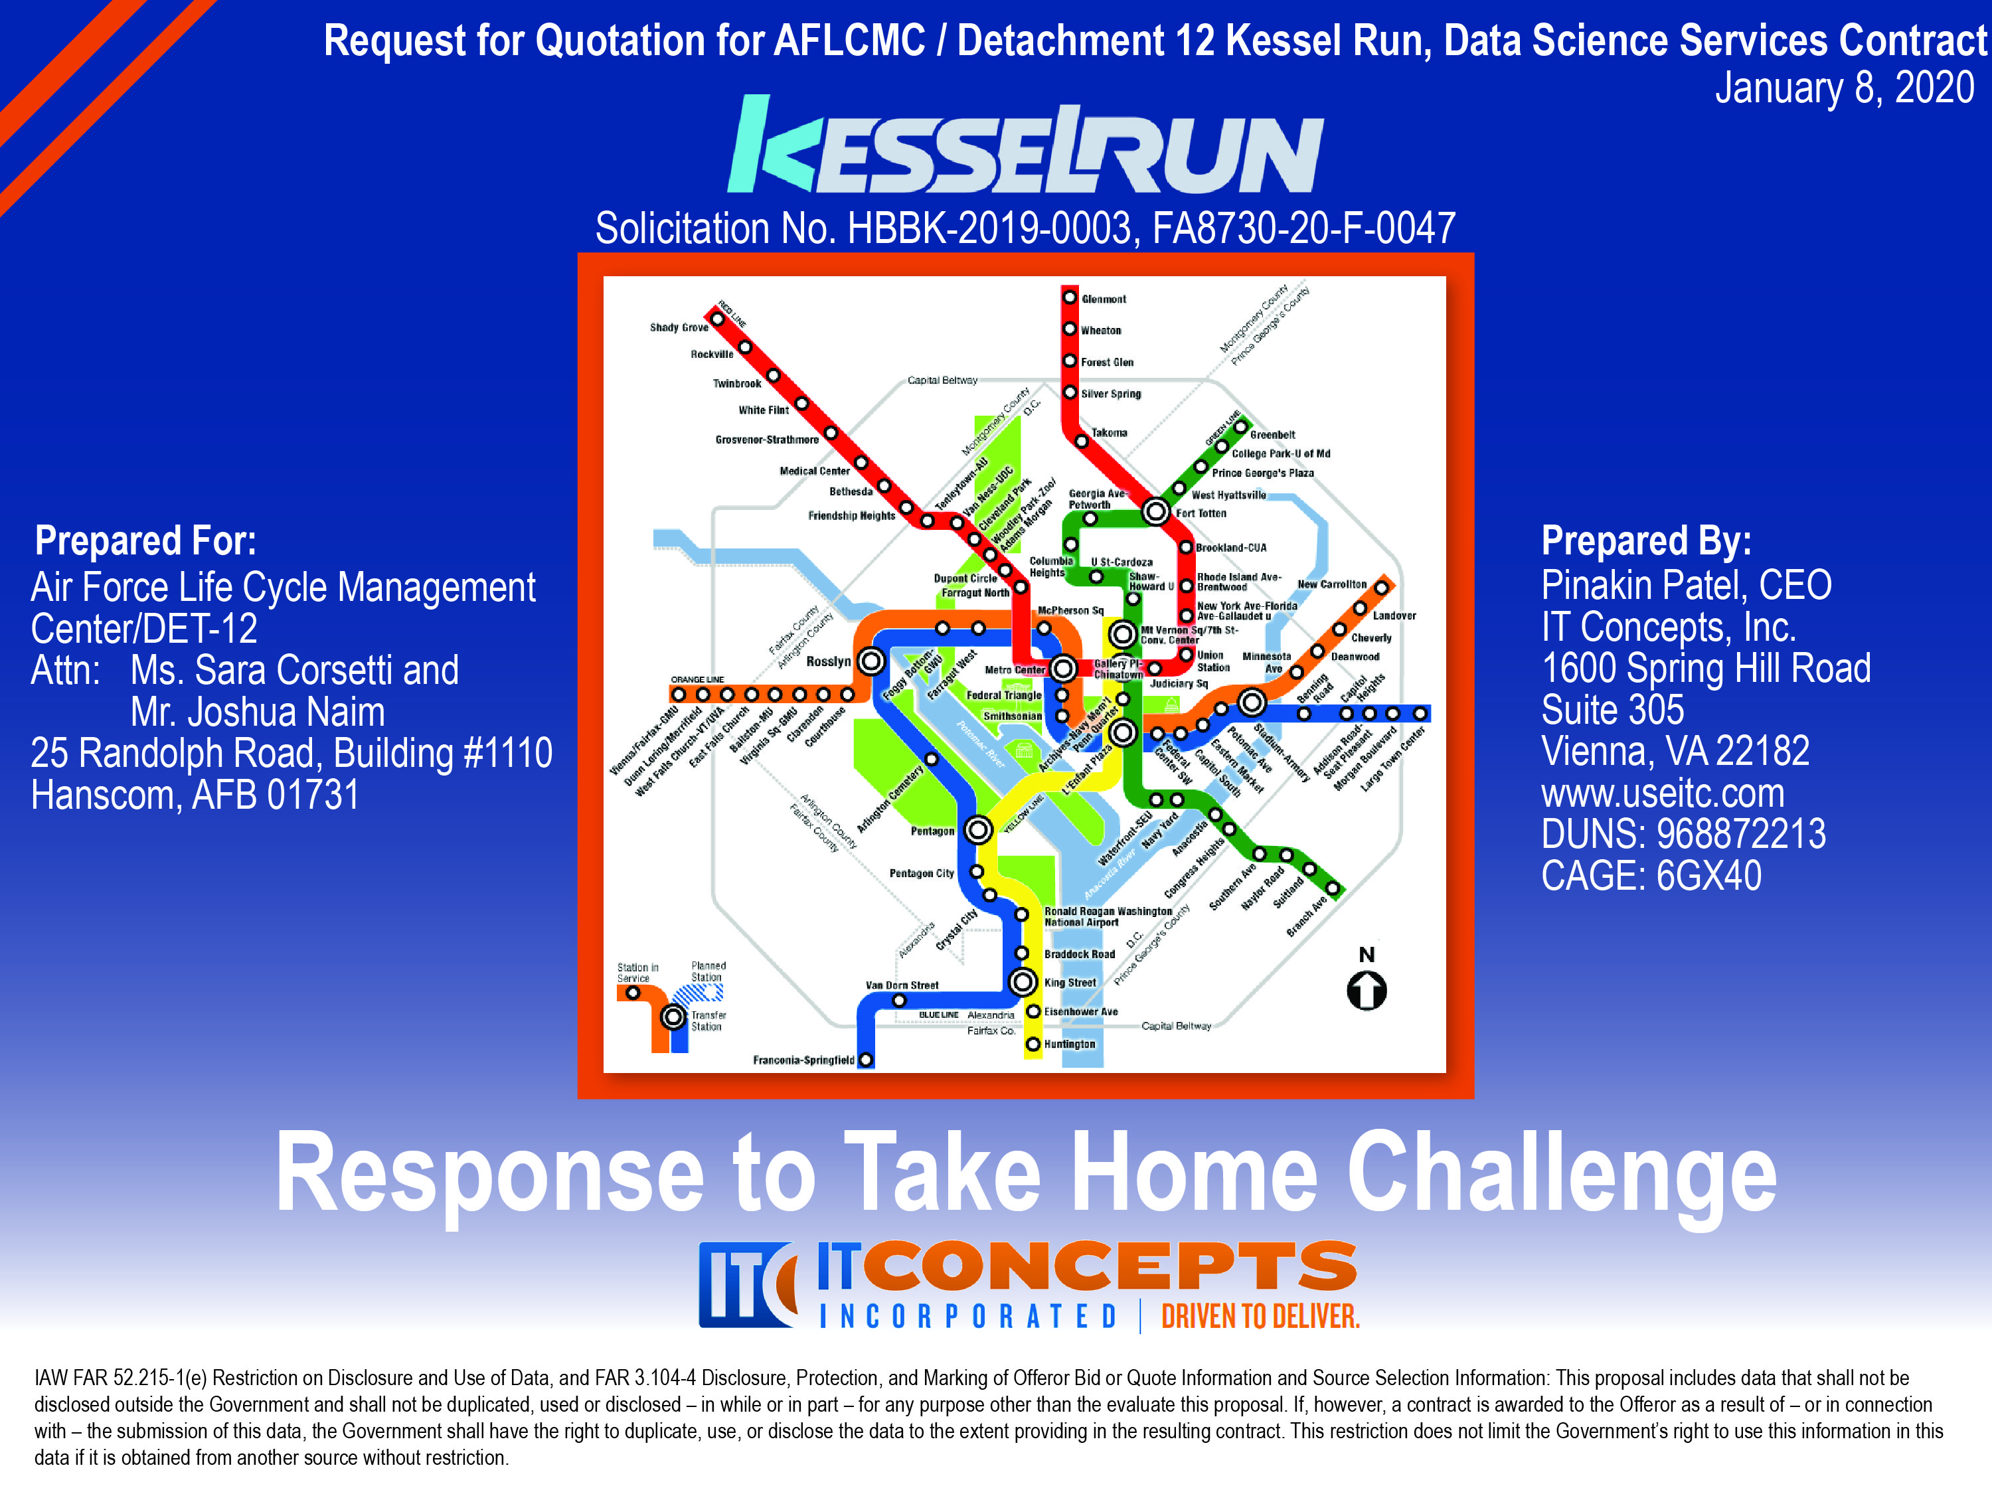


Slide 2

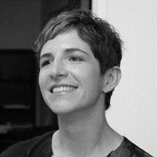

Introduction of Key Personnel
Data Engineer
Data Scientist
Reinforcement Learning Engineer
B.S. Management Science
Committed to solving challenging national defense problems with advanced mathematical and scientific methods with state-of-the-art decision aid technologies
15+ experience designing, building, implementing, and optimizing data engineering architectures across DoD (USN, etc.) and the IC (NGA, etc.)
Current TS/SCI
Ph.D Physics / B.S. Chemical Engineering & Engineering Physics
Accomplished data scientist and operation research analyst with DoD (USN, DARPA, etc.) & NASA experience
10+ years of experience applying theoretical and practical data science analysis, machine learning, predictive modeling, optimization, etc.
Current TS/SCI
M.S. Computer Science / B.S. Economics & Computer Science
Adjunct Professor – M.S. Data Analytics (The George Washington University)
Data science/reinforcement learning expert with cutting-edge tools, techniques, methodologies, approaches
Large volume data management using Azure/AWS, NoSQL, Jupyter, etc.
Interim Secret (TS/SCI submitted)
Thomas J. Rowe. Jr.
Dr. Adrienne Juett
Joel Klein
Authors of Presentation: Key Personnel
Data Engineer: Thomas J. Rowe, Jr.
Data Scientist: Adrienne Juett
Reinforcement Learning Engineer: Joel Klein
Other Contributors
Program Manager: Jon Hammond
Data Scientist: John Martellaro

Slide 3
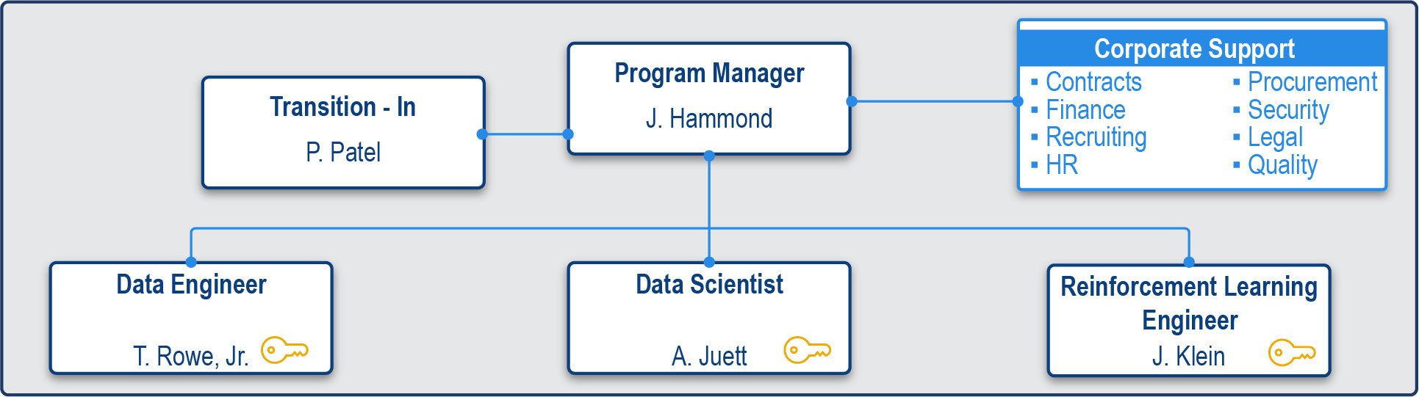


IT Concepts Organization & Team
Teammate | Benefits to Kessel Run
IT Concepts (8(a), SDVOSB) | Dynamic IT engineering supporting DoD and intel community (IC) data-centric programs Award winning, (8)a) SDVOSB - Washington Business Journal’s Best Places to Work, etc SecDevOps expertise provides an integrated and standard set of tools and methods that reduce security risk while simultaneously meeting objectives of faster and more cost-effective delivery For DIA, 20+ SCM-certified engineers deployed 75+ microservices across 17 apps; achieved 50+ ATOs Currently supporting the AF – SAF/MG and A3 Cloud-agnostic service expertise – e.g., AWS, Azure IAW NIST 800-53, 800-171, FEDRAMP TS/FCL; CMMI DEV/SVC-3 and ISO 9001:2015, ISO 20000-1:2011, and ISO 27001:2013
Metron | Dedicated to solving challenging operation research problems in national defense through the development and application of advanced mathematical methods Use of A9 STORM tool; NSS, ExAMS/Assassin, and other modeling from physical to operational; 4+ non-linear data fusion products (NodeStar, Paladin, TerrAlert)

Slide 4

Why IT Concepts
Kessel Run Objectives
Design, develop, & deliver enterprise data science services
IT Concepts Approach to Meet Objectives
Data Management: Create and maintain data pipeline architectures to automate the processing of large and complex data sets.
Data Visualization: Develop graphical representations of information and data. By using visual elements like charts, graphs, and maps, data visualization tools provide an accessible way to see and understand trends, outliers, and patterns in data.
Data Optimization: Build sophisticated optimization models, and create algorithms for quickly producing near optimal solutions according to those models.
Reinforcement Learning: Utilize machine learning concepts to enable iterative learning in a dynamic data environment by trial and error using feedback from events and monitoring.
Mission-Aligned Data Management Strategy
Our data engineers are involved from the beginning, working to understand not only what data is to be collected, but how that data is to be used, where it comes from, data retention or data privacy policies - the architecture is created with the full picture in mind.
Data-driven Decision Making
We use established COTS and open source visualization tools, such as Tableau and Plot.ly, to provide a flexible and comfortable environment for users to explore their data.
Our approach focuses on: (1) Identifying the User, (2) Identify the data, (3) Hosting Visualizations
Sophisticated Data Optimization Modeling
We identify and evaluate alternative designs and operating policies in our model and compare their predicted performance with the desired mission goals and objectives.
Designed to provide optimal values for design variables leading to high performance.
ML-based Reinforcement Learning Models
We identify and evaluate alternative designs and operating policies in our model and compare their predicted performance with the desired mission goals and objectives.
Designed to provide optimal values for design variables leading to high performance.
a. Create and maintain data pipeline architectures to automate the processing of large and complex data sets.
b. Work with product teams, users, and other stakeholders to identify opportunities for data-driven solutions.
c. Work closely with product teams to implement Reinforcement Learning features at the application and database level.
d. Work with product teams, users, and other stakeholders to identify and build optimization and simulation models for highly complex processes.
e. Hire and retain quality staff to support Kessel Run’s Data Science needs.
f. Provide surge services in the event of unforeseen or future requirements.
Working with standards such as AF OMS and UCI to ensure data compatibility and consistency in analysis and combined with our data experience, we take your data from collection to action.
Pairing data scientists with mission SMEs and SW engineers, we deliver fully functional and supported analytical support systems in cloud-based environments, through examination and creation of algorithms.
Distributing the work amongst functional teams that coordinate within preexisting frameworks, ensuring that any solution remains adaptable and deployable – from requirements to experimentation to continual improvement
Using modeling to identify optimal solutions, determine performance requirements and/or identify appropriate operational concepts for system employment.
Focusing on building a pipeline of technical talent, constantly creating rapport with the “best in tech” candidates, sometimes even years before they are even job hunting. Regardless of project size, our average time to onboard across all programs is 14 business days.

Slide 5











Why IT Concepts for Kessel Run
Functionality
Thoroughness of Documentation
Designed and Implemented an Event Driven Data system
Developed analytics using a new-to-ITC data feed
Data ingest from APIs in two formats
24x7 Operational Monitoring
Single Pane of Glass / User-Centric Dashboards using Plot.ly
Use of MongoDB for replay and testing
Comprehensive documentation for installation, user operation, and O&M
Installation Guide
Architecture Diagrams
Open code base (Git)
Demonstrated Data Management expertise / experience
Transparent Agile Process
Data Science Expertise
Data Engineering Expertise
Biased for Action
Full Lifecycle Support
Simplicity
Clarity of Data Transport and Transformation Structure
Future-proof Docker-based implementation for scalability
Efficient use of existing containers
Concurrent local development through Docker while infrastructure stood up
Rapid stand-up through use of AWS
Kessel Run Partner
Insight into data transformation structure through use of ELK Stack (Kibana, Filebeat, Metricbeat, ElasticSearch)
Simple transport from source to Kafka, analytics, and dashboards
Invested in Your Success
Performance Driven

Slide 6


Take Home Challenge

Slide 7
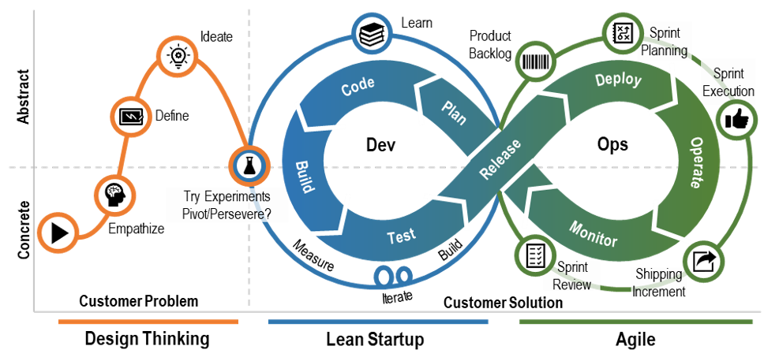
ITC Technical Approach
Implemented Kanban approach to Agile for this rapid design, development, and delivery of the ITC Kessel Run Challenge
Real-time communication of capacity for full transparency of work planning and progress – using our Kanban Board, allowing team members to see the state of every piece of work at any time. We broke down work items into small units in order to reduce risk.
Tested ideas through frequent iterations to discover customer preferences and behavior through objective metrics
Design Thinking and Lean Start-Up Phases provided preliminary results while the data engineering and SecDevOps teams focus on the data pipeline and to resolve the data collection, validation, and cleaning prior to any in-depth analysis

Slide 8
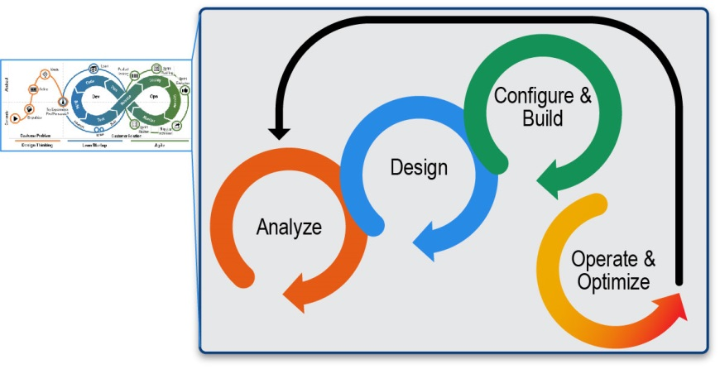
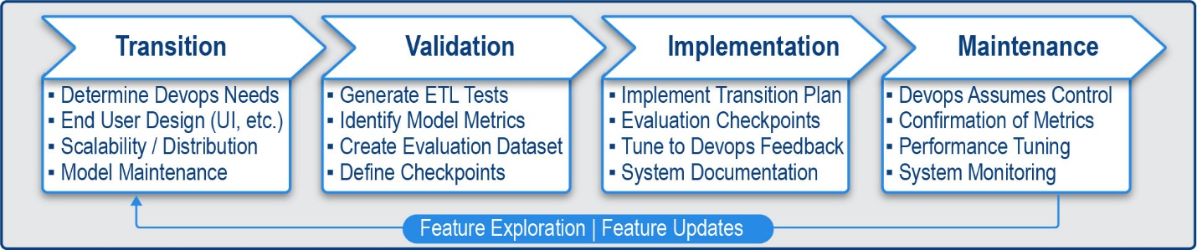
ITC Technical Approach with Rapid Model Experimentation
Overarching approach combines a Lean Start-Up with Agile mindset using SecDevOps with the Analytics Solutions Unified Method for Data Mining (ASUM-DM) framework maximizing the success of Data Engineering and Analytics projects
Our three-part approach meets the overall program objectives for Kessel Run Data Science
By incorporating our approach to Rapid Model Experimentation, we can build fast and fail fast when experimenting with RL models

Slide 9
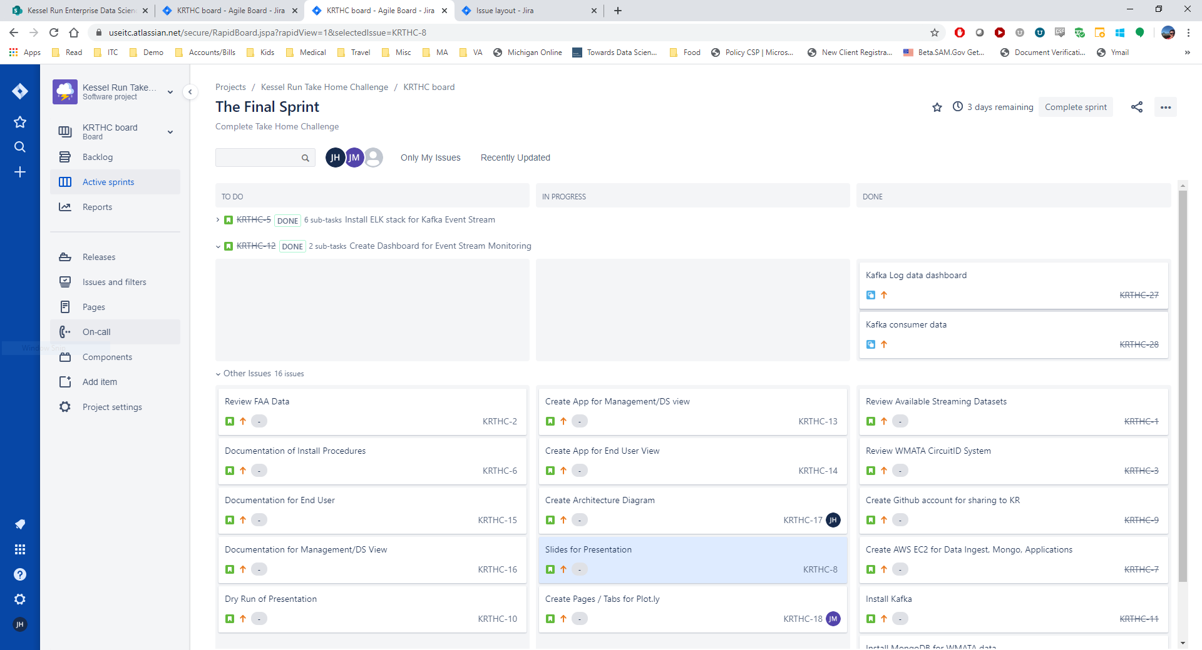
Agile Development Process (Kanban)
Features | Benefit to Kessel Run
Functionality | Kanban allows us to start fast without spending a lot of time detailing user stories since stakeholders are not available
Simplicity | Kanban provided the simplicity to standup a new team fast for a less than 7 calendar day turn. We track progress without an overburdened process. In the future, we revert to a lean agile sprint process with two week turns
Thoroughness of Documentation | Running an Agile Kanban process allows us to collect and document the work product

Slide 10
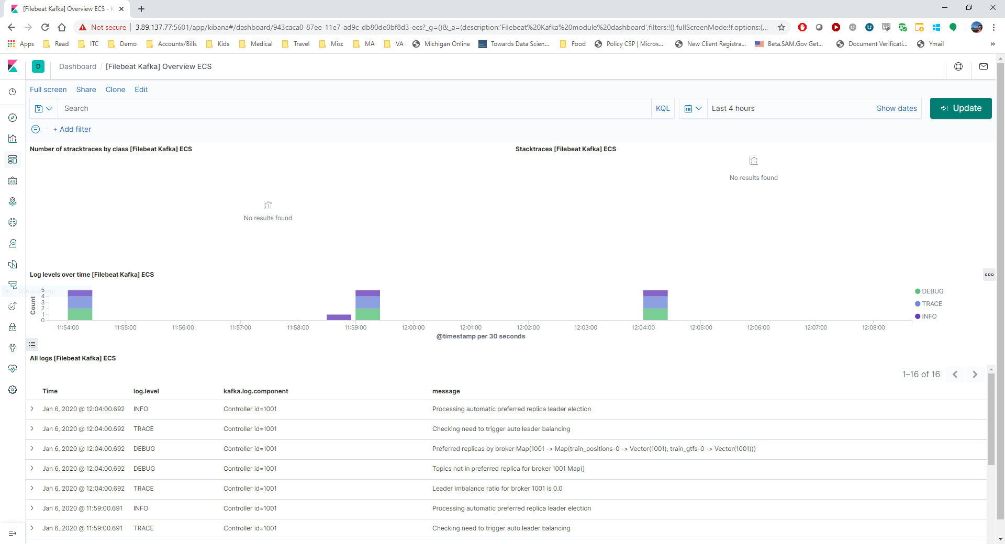
Kafka Monitoring Dashboard
Features | Benefit to Kessel Run
Functionality | Detailed information on the Kafka processes
Simplicity | Easy to read dashboard provides a initial platform for monitoring the data stream
Thoroughness of Documentation | Access to detailed log data without logging in
Clarity | Insight into the overall status of the Kafka data event stream

Slide 11
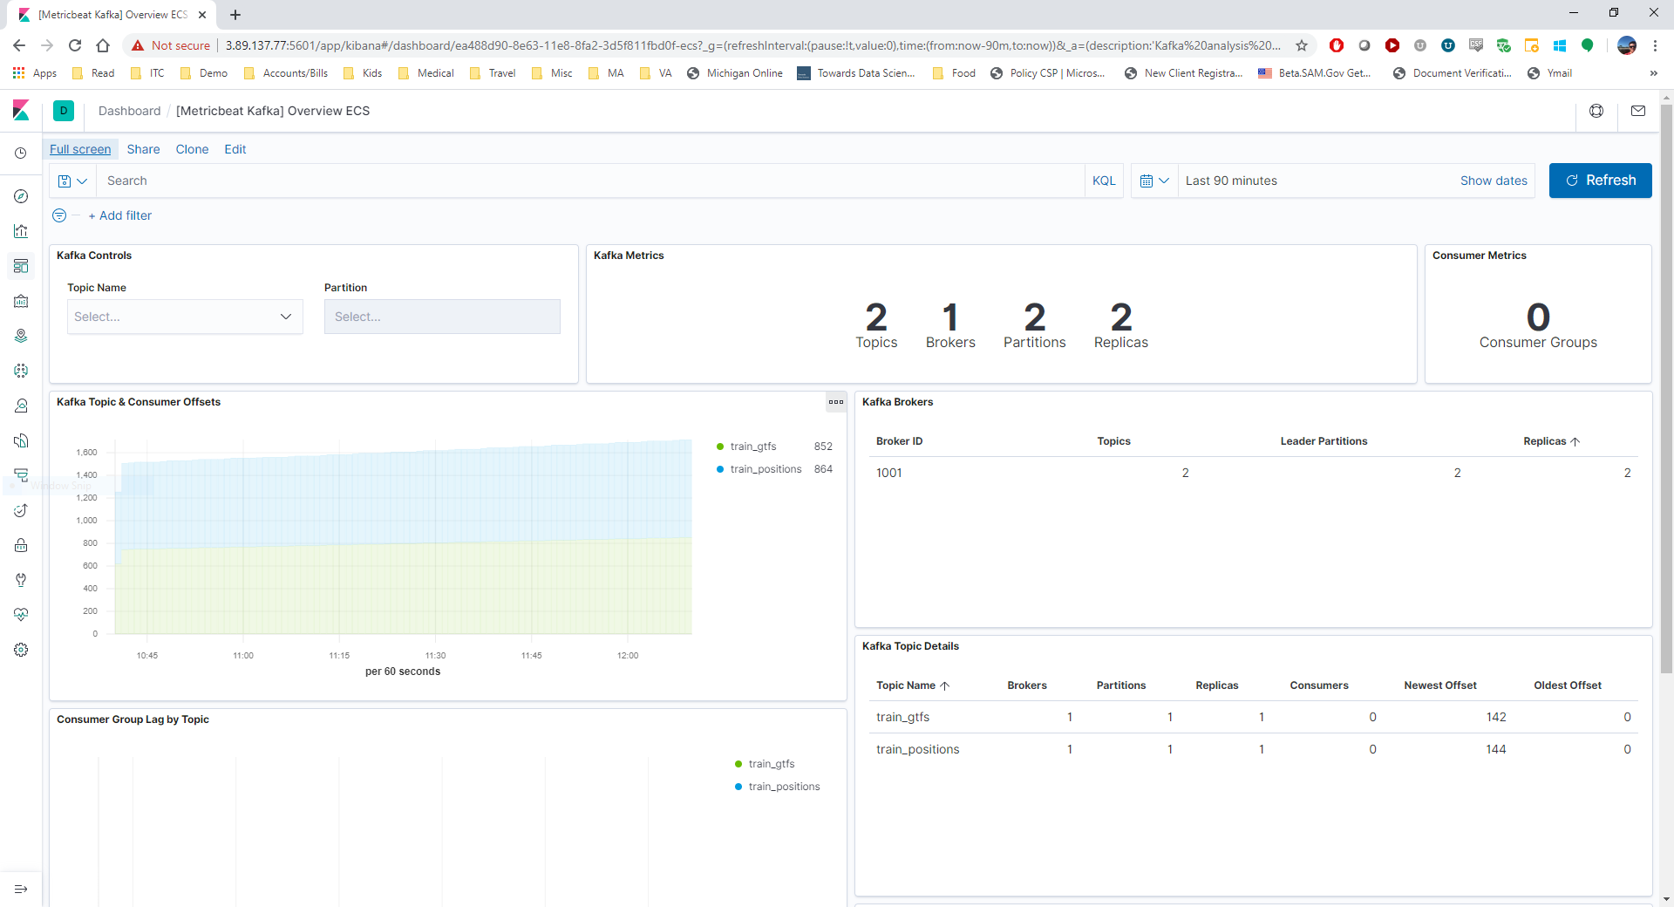
Kafka Topic Metrics Dashboard
Features | Benefit to Kessel Run
Functionality | Detailed information on the Kafka topics, partitions, replicas
Simplicity | Easy to read dashboard provides a initial platform for monitoring the data topics, indexes and lag
Thoroughness of Documentation | Provides a quick glance of the topics to ensure data ingest is occurring properly with access to log information
Clarity | Insight into the overall status of the Kafka data event stream

Slide 12
Data Selection
Valid Data Source Requirements
WMATA API
Accessibility – Given time constraints any datasets that could not be made immediately available would be time prohibitive
Usability – The data needed to be able to drive interesting analysis
Streamability – Given the prompt, the data source must be a stream of data or a dataset that could emulate a stream
Accessibility – WMATA provides a free developer version of their API. Access to the API is instantaneous and provides enough bandwidth to query for information at least every 5 minutes
Usability – Providing real-time information on a transit system provides a lot of opportunity to analyze trends and statistics about travel in the DC area. In addition, the work required to maintain a fleet of vehicles and ensure timely execution of operations holds some parallels to the needs of the Air Force
Streamability – Given that the data is a real-time status of operations, it easily adapts to streaming services like Kafka
12

Slide 13

Data Flow
Replay DB
WMATA API
Rest
Event Processing
Consumers
Producers
Central
Dashboard
GTFS API
ProtocolBuffers
Log Files
Filebeat Log Collector
Elastic-Search Index
Kibana
Dashboard
Metricbeat Topic Collector
Data Flow from Washington Metropolitan Area Transit Authority (WMATA) and General Transit Feed Specification (Google)
Use the WMATA API to collect and send data through our Kafka workflow where it is transformed into JSON
Our Consumers performs trending analysis, force directed categorization, and Bayesian analysis for prediction
Data is output into a Plot.ly dashboard for end user consumption
Monitor Kafka logs with FileBeat and ingest into ElasticSearch for display in a Kibana dashboard

Slide 14
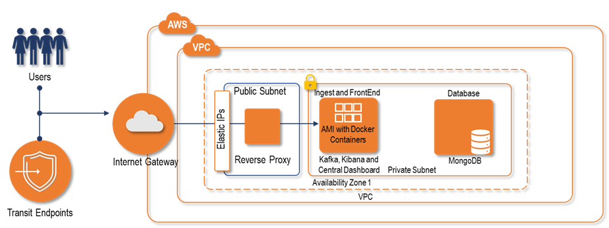
Physical Architecture
The ITC Team Take Home Challenge is contained within a single AWS VPN and exposed through security groups through a public subnet to end users. ITC has 2 EC2s to contain the demonstration applications
1: Configured with Kafka, Kibana, Filebeat, Elastic Search all within their own Docker containers
In a future iteration, each container will be separated for scaling
2: Contains the MongoDB Docker container
The MongoDB is used to store streaming data for replay as the data stream volume may not have been enough
In a future iteration, we will offload the database into AWS databases – e.g., RDS, Dynamo, etc.
For simplicity of deployment, we are using a single MongoDB

Slide 15
Stream Replay
Set up a Mongo instance as an intermediate point for the stream of API data.
Within Mongo, established collections for each of the API calls, ordered by their utc epoch time. This structure enables data scientists to treat the stream of data as either a static sample or a stream, depending on the algorithms and approaches
In addition to experimentation at that dataset level, the Mongo instance also act as a stream of data too. Leveraging the epoch field of each record, Kafka producers read from Mongo and recreate streams that had previously been seen. This is critical for time-sensitive data streams, as analyzing rush-hour vs off-peak streams can produce very different results
Through this implementation, data scientists can select a time to analyze and/or replay incidents to better understand how the stream may signal information before an actual event
Stream Replay
Considerations
Given the Kafka stream considerations, the primary focus while architecting the data stream workflow revolved around the rapid development of a flexible experimentation environment
Stream Replay Approach
Epoch | Data
1578317111 | {TrainPositions: […]}
1578316796 | {TrainPositions: […]}
1578316481 | {TrainPositions: […]}
Replay DB
WMATA API
Rest
Event Processing
Producer
GTFS API
ProtocolBuffers

Slide 16
Kafka Stream
WMATA API
Selected Kafka to handle the real-time stream of WMATA API data, as it provides a high level of customization for the producers and consumers
In addition, due to the maturity of the Kafka streaming process, there are a number of Docker-compose scripts that exist for rapid deployment as well as full python support. This meant more time could be spent focusing on developing the producers and consumers to manage and analyze the data stream
With Kafka topics generated for each of the API calls, the consumers consume/read the topics relevant to their function. The majority of the consumers play an analytical role, providing insights into the stream, but some also provide a direct stream of information to provide dynamic graphics for our dashboards
Considerations
With a REST API being provided by the WMATA API our producers simply need to make a request and then push the results out to Kafka/Mongo
The only major consideration needed was to determine the acceptable frequency given the free tier rate limits on the API
Real-Time Streaming Approach
Replay DB
WMATA API
Rest
Event Processing
Consumers
Producers
GTFS API
ProtocolBuffers

Slide 17
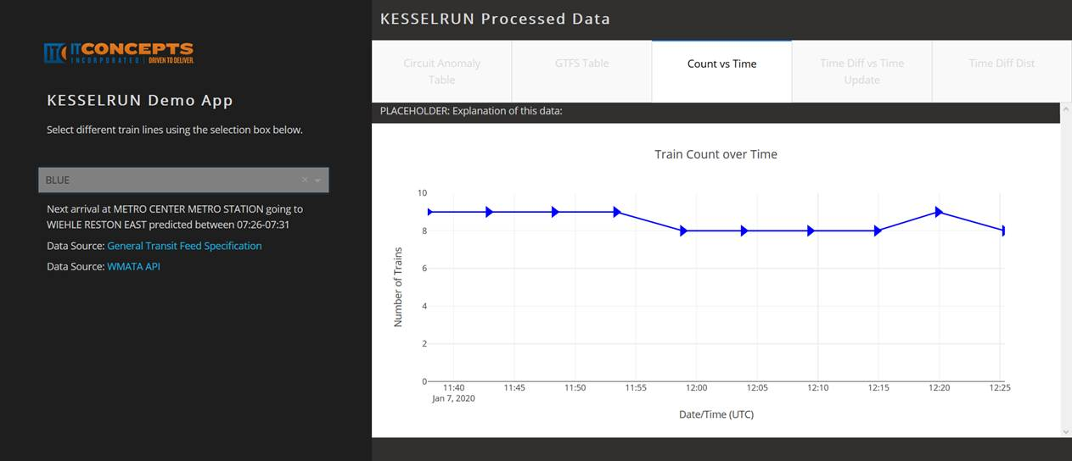
Dashboard
Designed the dashboard around pertinent WMATA management data elements - providing real-time information about line/train statuses and deviations from expected or normal behavior
Dashboard Input | Dashboard Element Description
Direct Calculation Based on Static Information vs Current Live Information | Train Count over Time – Quick glance at the number of trains actively running on the lines, by direction/line Trains on Schedule – Quick look at the spread of on-time vs. early vs. late trains Arrival Difference – Similar to Trains on Schedule, aggregated view of the information over the past n cycles
Additional Metrics/Insights | Improved Train Predictions – Predicted train arrival range for given line, station and direction Circuit Anomalies – Transit health monitoring system

Slide 18
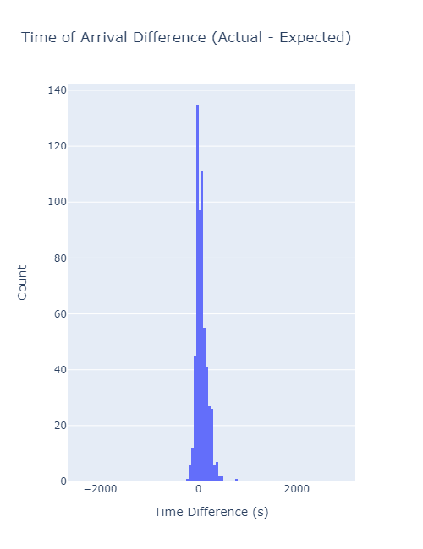
Improved Train Predictions
WMATA API
The Real-Time arrival data was used to calculate the deviation in arrival time from the scheduled time of arrival at each station. This delay time was then used to provide a prior for the expected delay probability distribution. The delay times used in predicting actual train arrival times were filtered on train line (color) and limited in time to 24 hours from the current time in order to provide a better estimate of the current state
As with any transit system, different periods of time can be expected to show different performance based on number of trains active, number of passengers to service, weather, and system malfunctions. Data from heavy usage periods (e.g. weekday rush hour) may not be a good proxy for low usage times (e.g. Sunday morning)
The predicted times utilizes the daily train schedule and corrects for the delays measured in the system. The output provides a range in the next expected arrival time that includes the 90% expected delay
Considerations
Metro currently provides an API that informs passengers of the next train arrivals. This is one of the key API’s for riders as it provides real-time updates at metro stations and on phones
Given the significance of this functionality, it became an area of focus for us to explore and see how we might be able to create an improved model
Due to the limited time frame of the effort and the lack of past data on which to develop the model, a naïve approach was taken to create the prediction model
Real-Time Streaming Approach
Next Steps
Next Steps/Improvements | Benefit to Kessel Run
Conditions of interest: Day (Weekday, Weekend, Holiday), Time of Day (Rush v non-Rush), Weather, Planned service work, Unplanned system malfunctions, Events (e.g. sporting event, rally), etc. | Improvements to the prediction system could be made by correlating the delays with various factors to provide a better estimate of the “typical” behavior under those conditions
Trains that are ADDED (i.e. not on the static schedule) | Inclusion of these systems would require using the real-time data to determine if an ADDED train is traveling toward the station of interest in the direction requested and then comparing the ADDED train arrival times to similar SCHEDULED trips to predict the arrival time
Next Arrival at Metro Center going East (~21:45)

Slide 19
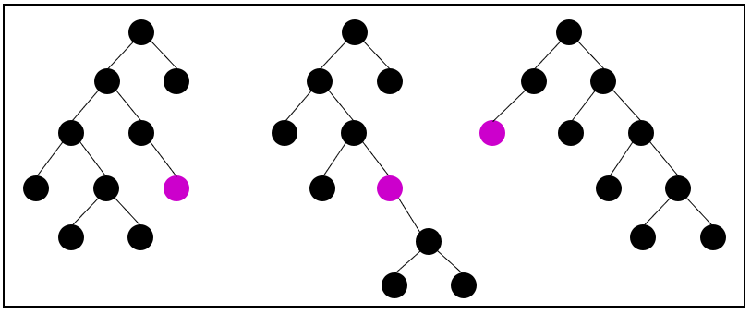
Circuit Anomalies
Tracking Transit Health Status
To circumvent this issue, we leveraged an unsupervised algorithm called Robust Random Cut Forest (RRCF). This algorithm is designed to work with streaming datasets and provide real-time analysis of the data. It works by analyzing the stream of information to locate anomalous behavior
Being an unsupervised ML model, RRCF does not need to be trained prior to being deployed. Instead the results need to be contextualized to better understand the results produced
This model works by creating an ensemble of binary trees, generated by the most recent datapoints. For each additional datapoint, the algorithm tracks how much the tree changed (in shape). The aggregate changes to the forest are then what is used to produce an anomaly score for the datapoint
Normalcy
Tracking the health status of an entire transit is a complex problem, one of the largest complications is that, especially for the DMV area, there is no normalcy
Very frequently there are lines being single tracked (meaning only one direction can move at a time), construction is being done, certain routes may be shutdown, etc.
This volatility can confound most predictive algorithms, as they focus on identifying a pattern in previously seen data. If the trains are not operating normally, then most traditional algorithms that analyze historic data will get tripped up
Robust Random Cut Forest
Changing Tree Shape With Insertion
Source: https://www.linkedin.com/pulse/robust-random-cut-forest-rrcf-math-explanation-logan-wilt/

Slide 20
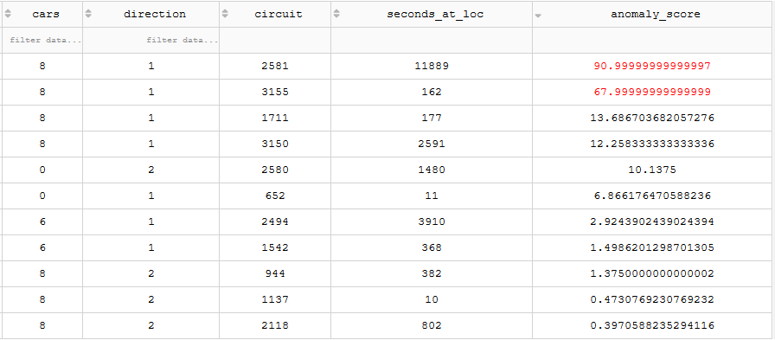
Circuit Anomalies Cont.
Metric Development
Volatile Data
To capture this information, we created a table dashboard that highlights anomalous points of interest. In this manner, any analyst can quickly check to see what circuits may be causing a problem and/or identify track issues prior to any official notice
Ultimately, in this form, RRCF provides information and context to a user, but not actionable information. Analysts can then combine their domain knowledge with the insights created by the dashboard to identify circuits that need intervention
The issue for developing metrics that critically analyze the current status of the circuit information draws upon the complications mentioned earlier; transit data is highly volatile and subject to random events
It is difficult to build a static representation of what would be expected for any given circuit, as the operations of the metro system are not very stable
Anomalous Points of Interest Dashboard
Value of Streaming Anomaly Detection (e.g., RRCF) when Applied to WMATA Circuit Data
The circuit data tracks the location of all of the metro trains as they pass certain circuit signals. The API tracks the time, direction, and number of cars for each train traversing the circuits.
RRCF doesn’t try to analyze current operations against historic, it simply analyzes the shifting pattern of the current stream of data. It is constantly adapting to current operations while attempting to identify any behaviors that do not conform to that operational pattern
RRCF is great for detecting significant shifts in how trains are traversing any given circuit

Slide 21
Reinforcement Learning Environment
Hub Transfer
While the DC metro is simple enough that a predictive model would most likely come to an optimal solution, the structure of the problem lends itself well to reinforcement learning. In this scenario the Agent or model would need to identify the ideal path through the metro system based it’s starting location, target location, and available routes.
The first step to implementing this approach requires developing the environment in which the RL agent could interact with. A diagram of this environment can be found below:
Considerations
One of the common problems faced by commuters taking the DC metro is determining which major hubs to transfer lines. The complication arises due to the fact that the next arriving train may take a more circuitous route than one arriving later.
The question becomes, is the extra travel time greater than the time for the train on the shorter route?
Reinforcement Learning
Initially - DQN
Agent
Action | Reward
Invalid | -1
Moved | 1
Target Station | 100
Line | Direction
RED | 1
RED | 2
BLUE | 1
… | …
State
S_{t}
Reward
R_{t}
Action
A_{t}
_{Rt+1}
Environment
S_{t+1}
Current Station | Target Station | Silver-1 | Silver-2 | Red-1 | …
Spring Hill | Pentagon | 1 | 1 | -1 | …

Slide 22
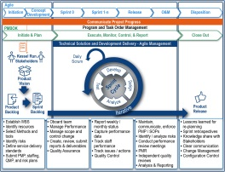
Agile Retrospective
Challenge | Approach | Next Steps
Stakeholders | Used ITC Executives as stand-in stakeholders in order to create a group to use for requirements gathering. | In the future we’d have actual stakeholders.
Acquiring Streaming Data Source | Investigated multiple sources include WMATA and FAA. Criteria largely based on availability of data and richness of data and APIs. | We believe this will be standard operating procedure going forward.
Resource Availability | Many internal resources were returning from vacation and use of lose PTO. Curated a team based on available resource and added additional as they became available. | We believe we were able to add all needed resources in spite of the holidays and going forward with a more stable team we can plan resources more thoroughly.
Analytics Design while Infrastructure being built (local into production) | As the timeline was short, we wanted to have our data scientists do their exploration prior to a full environment being available. We used Docker containers and a Mongo database to allow for this. Mongo was necessary for replay of data and to give the scientists enough data to build models on. | In the future, we have an environment available with the tools necessary so there will be less churn at startup. We will continue to bias for action. This led us to being able to demonstrate value despite not having everything available day one.
Infrastructure Scalability | We used Docker container so that scalability in the future would be possible. This also worked well to help with development. | Docker compose and install scripts need cleanup to remove hardcoded values and overrides. Create Cloud templates to ease creation of infrastructure.
Analytics designs in Spyder and PyCharm | Each data scientist and engineer used different notebooks and development environments. This led to some integration issues. To mitigate this we included Conda YML files to allow synchronized environments. | We would continue with the shared configuration files between environments and possibly shorten the list of tools to ensure maximum compatibility.
Timeline | We wanted to prove that we could support a from scratch environment so that KR could see we had the full set of skills necessary to perform this task. The timeline led us to take some shortcuts in architecture and environment setup that incur technical debt. We had additional analytics that we wanted to create, however it would require an extra week to go deeper. In addition, we switched to an Agile Kanban since the sprint was compressed to 6 days including standup. | We would revert to two week sprints going forward and change from Kanban to a more SCRUM like / lean Agile methodology.
Plot.ly Dashboards | Used plot.ly as the quickest path forward for a responsive dashboard. Plot.ly requires further configuration and design time to act as a larger dashboard | Investigate other dashboarding solutions for the future.

Slide 23
Why IT Concepts?

Slide 24
Why IT Concepts for Kessel Run
Functionality
Thoroughness of Documentation
Designed and Implemented an Event Driven Data system
Developed analytics using a new-to-ITC data feed
Data ingest from APIs in two formats
24x7 Operational Monitoring
Single Pane of Glass User-Centric Dashboards using Plot.ly
Use of MongoDB for replay and testing
Comprehensive documentation for installation, user operation, and O&M
Installation Guide
Architecture Diagrams
Open codebase available in Git
Demonstrated Data Management expertise / experience
Transparent Agile Process
Data Science Expertise
Data Engineering Expertise
Biased for Action
Full Lifecycle Support
Simplicity
Clarity of Data Transport and Transformation Structure
Future-proof Docker-based implementation for scalability
Efficient use of existing containers
Concurrent local development through Docker while infrastructure was stood up
Rapid stand-up through use of AWS
Kessel Run Partner
Insight into data transformation structure through use of ELK Stack (Kibana, Filebeat, Metricbeat, ElasticSearch)
Simple transport from source to kafka, analytics, and dashboards
Invested in Your Success
Performance Driven

Slide 25
Access Links
Analytics Dashboard: http://3.81.9.232:8050/
Kibana Dashboard: http://3.89.137.77:5601/
Github: https://github.com/itconceptsinc/kr
Jira: https://useitc.atlassian.net/browse/KRTHC
User: kesselrun@useitc.com
Password:kesselrun1!
SSH: 3.89.137.22 and 3.81.9.232 (PEM file available upon request)

